Slide 1
Automated Text Analysis Application Demo
An application for topic modeling

Slide 2
Topic Modeling
Discover the hidden and abstract “topics” in a collection of text documents.
Algorithm used: Latent Dirichlet Allocation (LDA).
Each generated topic is a distribution of words.
e.g. 0.058*"candidate" + 0.041*"internal" + 0.039*"hire" + 0.028*"qualified" + 0.022*"position" + 0.017*"externally" + 0.017*"external" + 0.011*"internally" + 0.011*"federal" + 0.011*"government"
User needs to label the topics themselves.

Slide 3
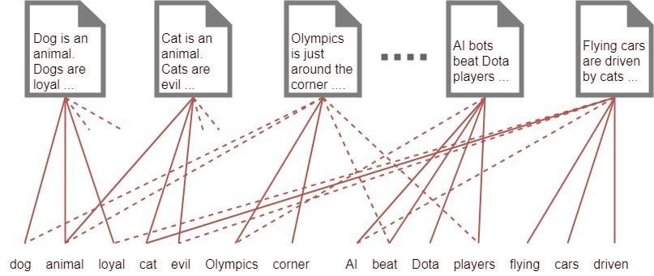
Topic Modeling
A document is consisted of words.

Slide 4
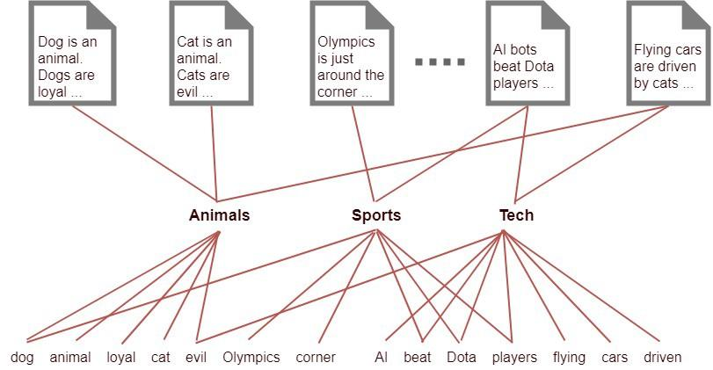
Topic Modeling
Discovering topics by running LDA algorithm against input documents

Slide 5
Automated Text Analysis Application
A Python desktop application wrapped around a TP model.
Python 3.8 or higher is required.
Source code: https://github.com/kapangyu-gsa/MD-Automated-Text-Analysis/tree/master/topicsanalyser

Slide 6
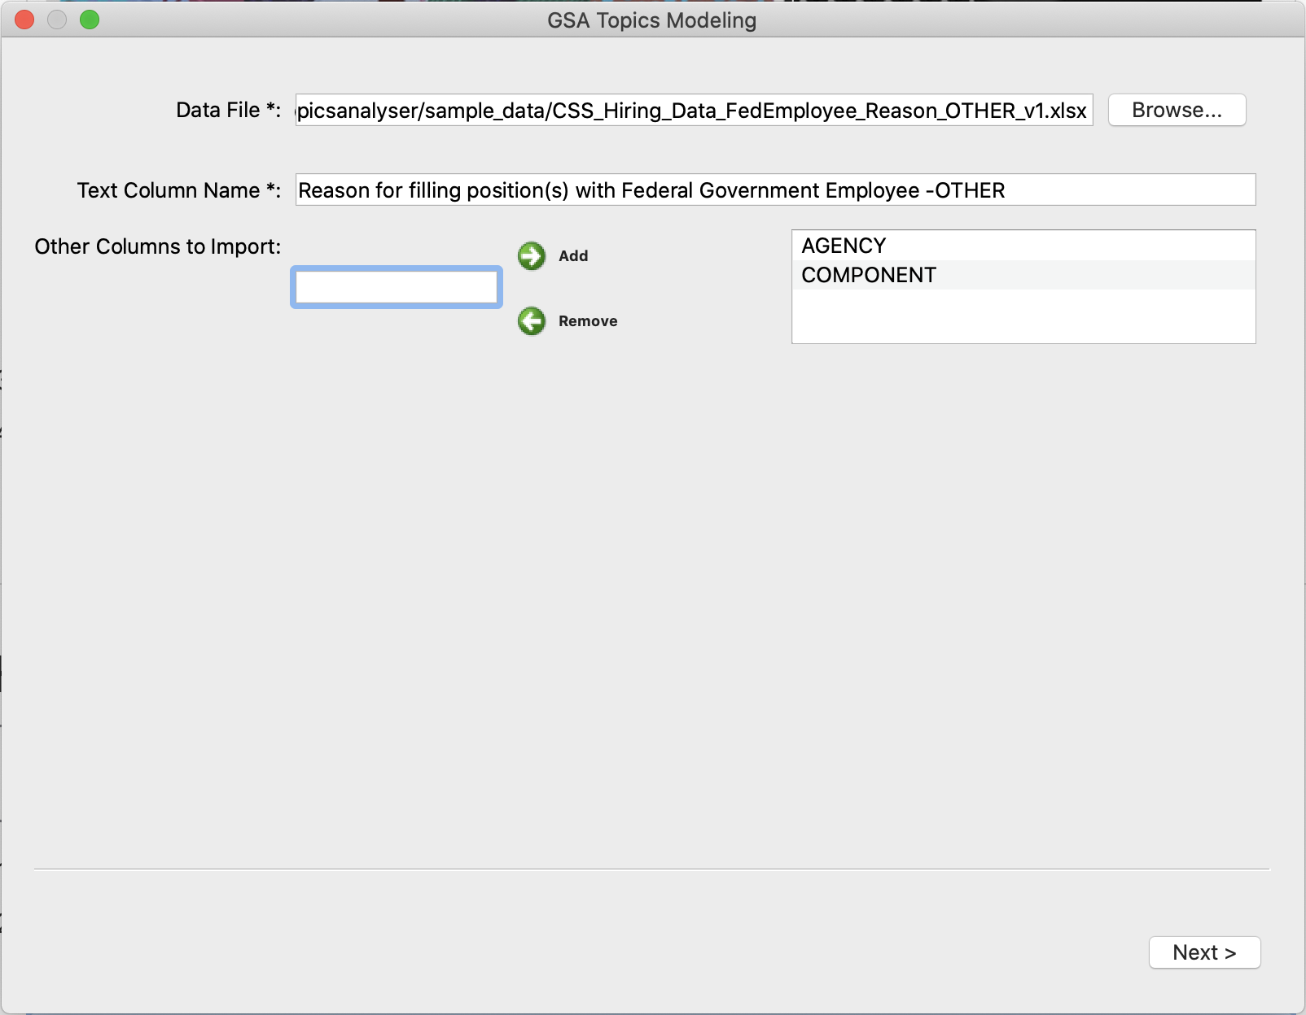
Automated Text Analysis Application

Slide 7
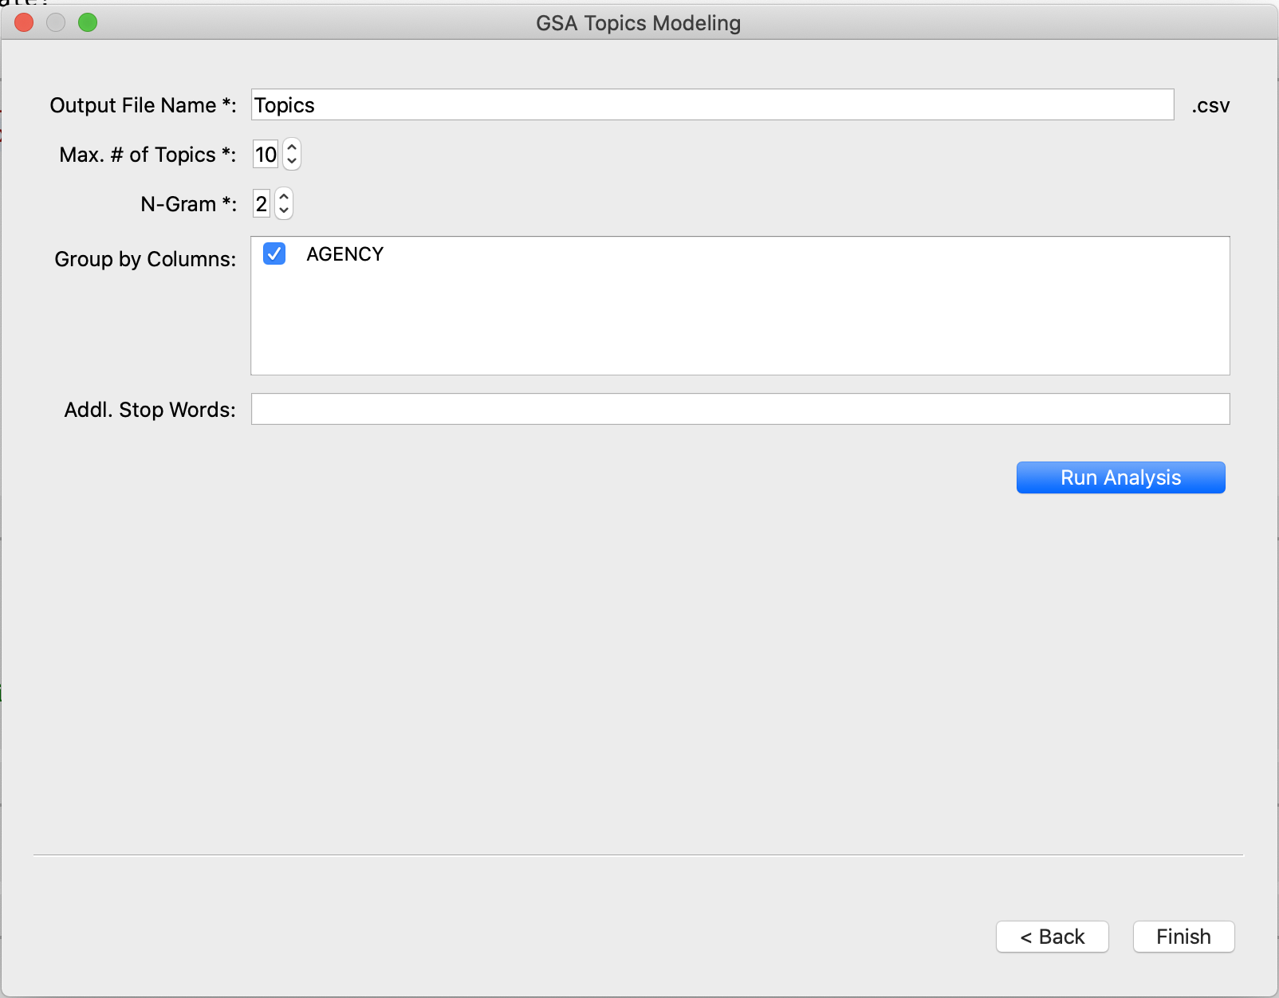
Automated Text Analysis Application

Slide 8
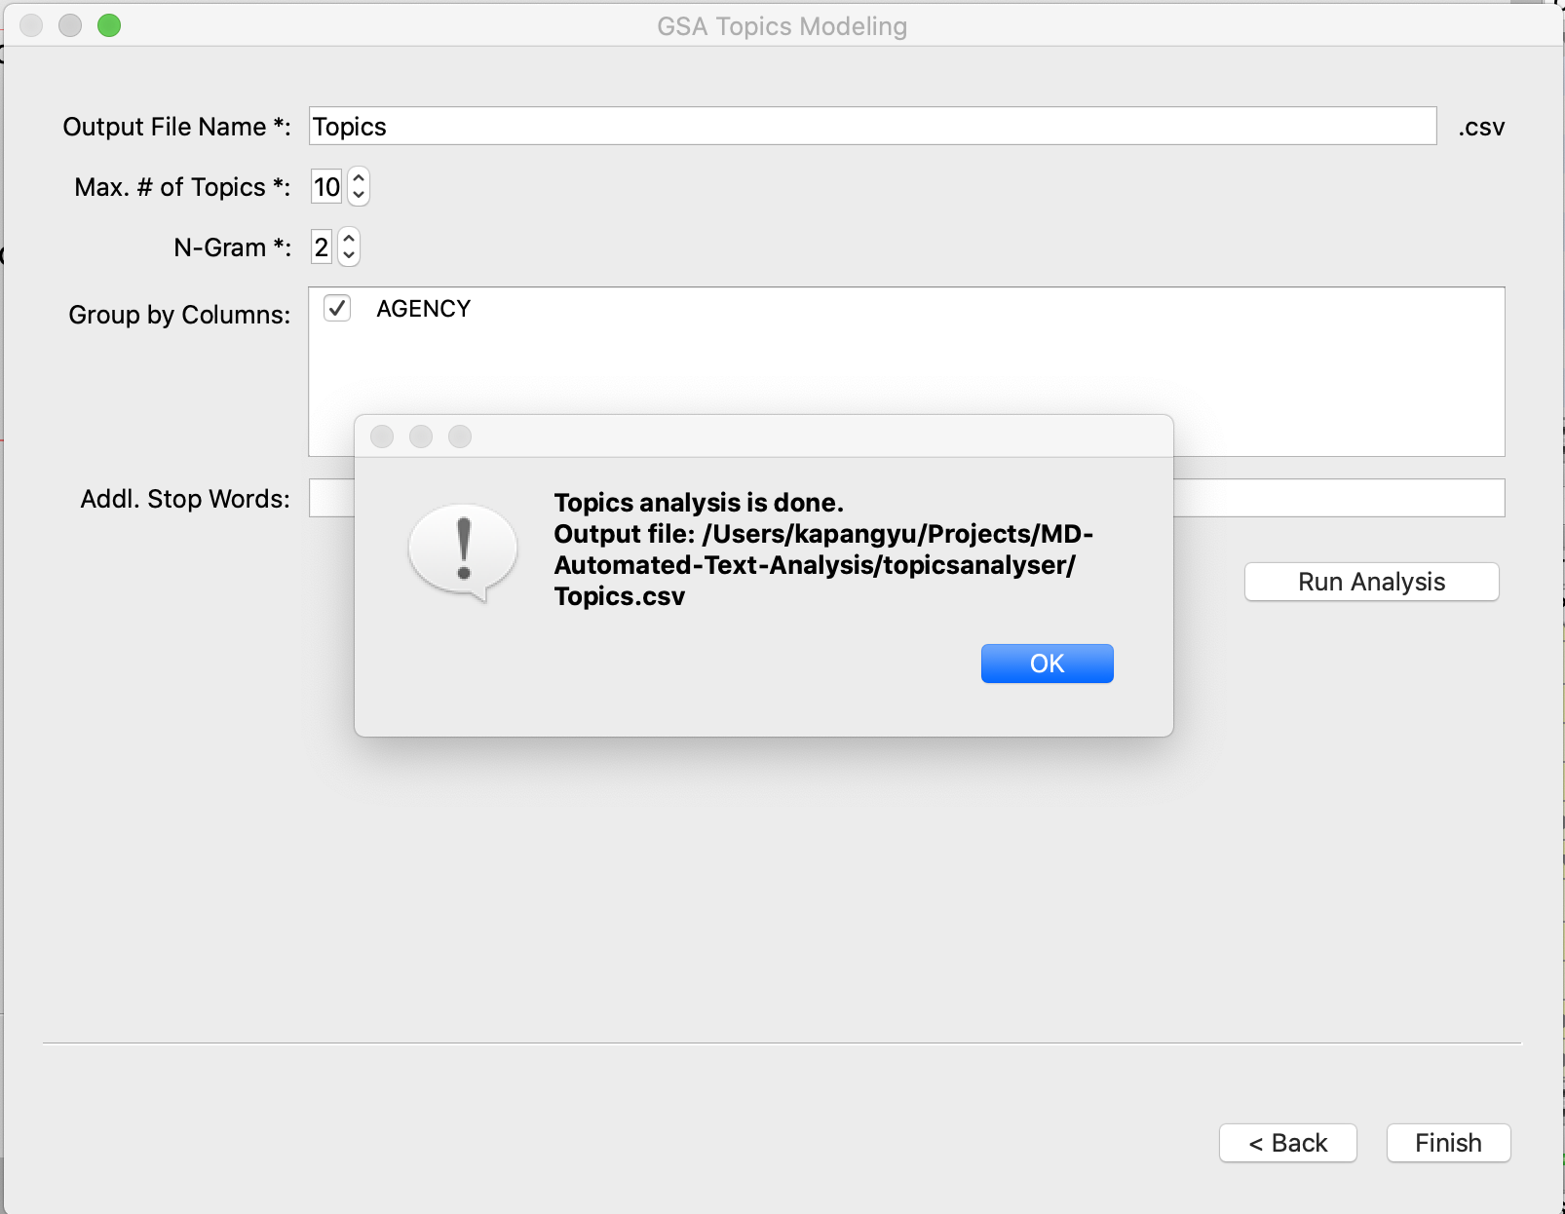
Automated Text Analysis Application

Slide 9
Automated Text Analysis Application
Demo

Slide 10
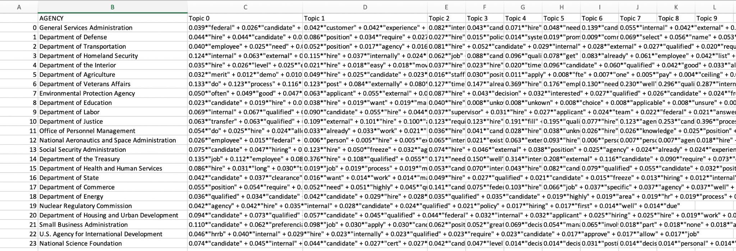
Automated Text Analysis Application
Output

Slide 11
Questions?

